Slide 1

Practice project PRS Driver Driver Dangerous Behavior
Detection System
Xu Chi
Zhou Danying
Zhu Xuanji

Slide 2



Agenda
1
Background
Project Scope
Process
Problem Statement
Project Objectives
Functional Description
Technical Approach
Input /Output
Data Preparation
Progress

Slide 3
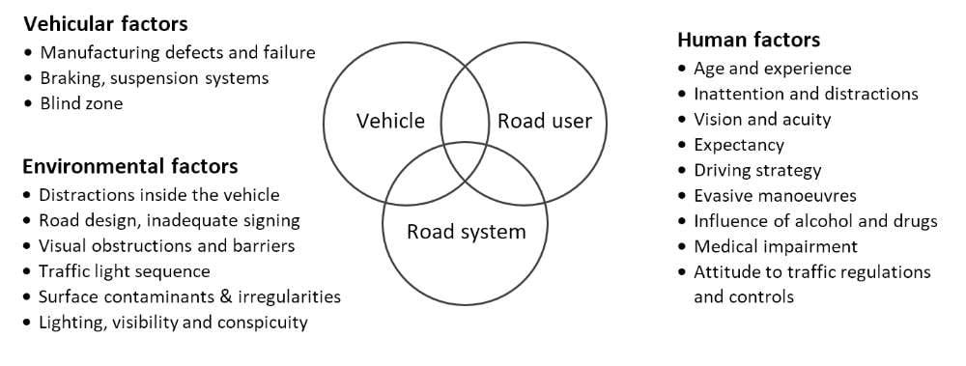
Background
2
Problem Statement
Traffic collisions are typically caused by a combination of factors related to three essential elements of the road traffic system: the road user, the vehicle, and the road system. We will refer to these contributing factors as the human, vehicular, and environmental factors, respectively. Refer to Figure 1. Among them, human factors are cited as probable causes in 80 to over 90 per cent of collisions.
Distracted driving behaviors, such as smoking, dozing off, and using mobile phones, contribute significantly to road accidents and fatalities.

Slide 4
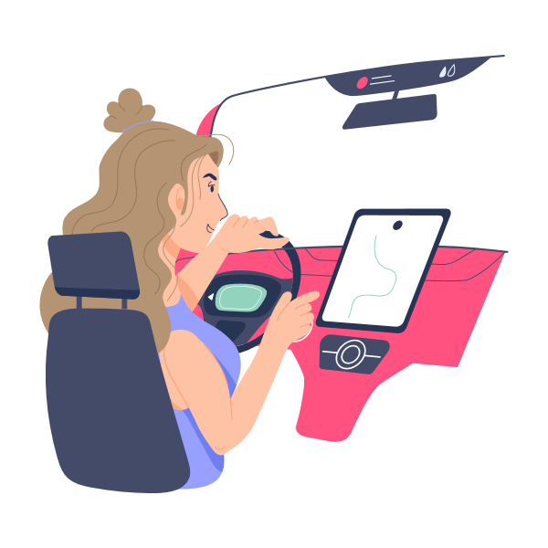
Background
2
Problem objectives
Driver Dangerous Behavior Detection System can play a pivotal role in improving road safety by providing timely warnings and helping reduce accident rates.
Such systems can act as a preventive measure, alerting drivers or taking automated actions to avoid potential accidents.

Slide 5
Project Scope
3
Drinking Detection: Use object detection models (e.g., YOLO) to detect if the driver is drinking while driving. The system will issue a warning signal when drinking is detected and highlight the detection result in the video stream.
Functional Description
Mobile Phone Usage Detection: Use object detection models (e.g., YOLO) to detect if the driver is using a mobile phone while driving. The system will issue an alert when mobile phone usage is detected and highlight the risky behavior in the video stream.
Drowsiness Detection: Use time-series analysis techniques (e.g., LSTM or 3D CNN) to analyze video frame sequences for signs of drowsiness, such as prolonged eye closure or head drooping. The system will trigger a fatigue alert via audio or visual signals when drowsiness is detected.

Slide 6




Project Scope - Technical Approach
3
Video Processing
Drinking and Mobile Phone Detection
Use OpenCV to extract frames from the video stream and analyze each frame
Use the YOLO object detection model to identify driver hand activities (drinking and mobile phone usage) from video frames.
Drowsiness Detection
Alert System
Use facial landmark detection libraries dlib to monitor eye and head posture changes and use 3D CNN, LSTM to process the time series of video frames to capture the continuous changes in behavior , calculating PERCLOS (percentage of eye closure) to determine drowsiness
When any dangerous behavior is detected, trigger alarms (sound, visual alerts, etc.) to warn the driver of the danger.

Slide 7
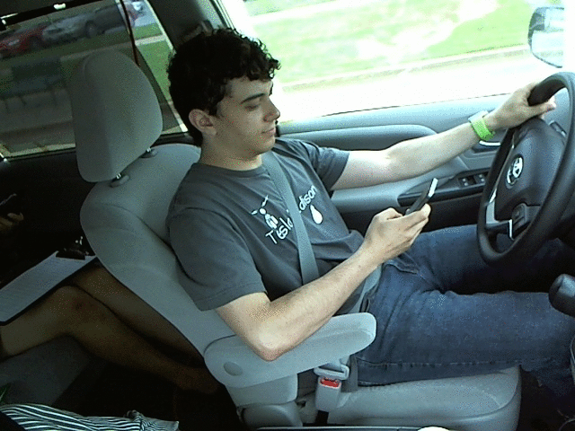
Process
4
Input
Pre-recorded video: Test and validate the detection capabilities using local video files.
Output
When drinking or mobile phone usage is detected, highlight the behavior in the video stream with bounding boxes and labels (e.g., “Phone Detected” or “Drink Detected”).
When dozing off is detected, display a “Drowsy Alert” on the screen along with a counter for eye closure duration.

Slide 8

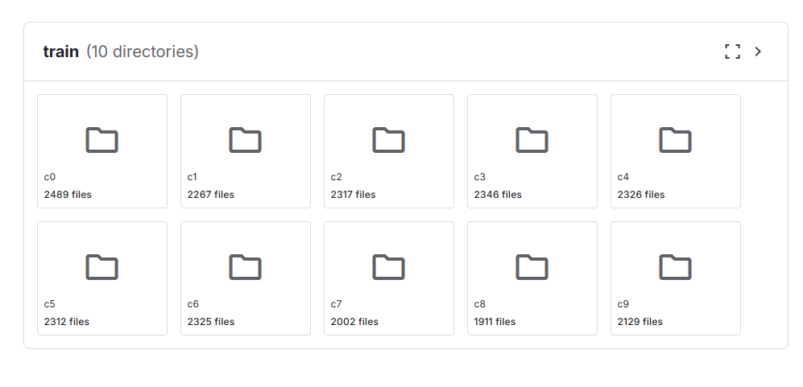
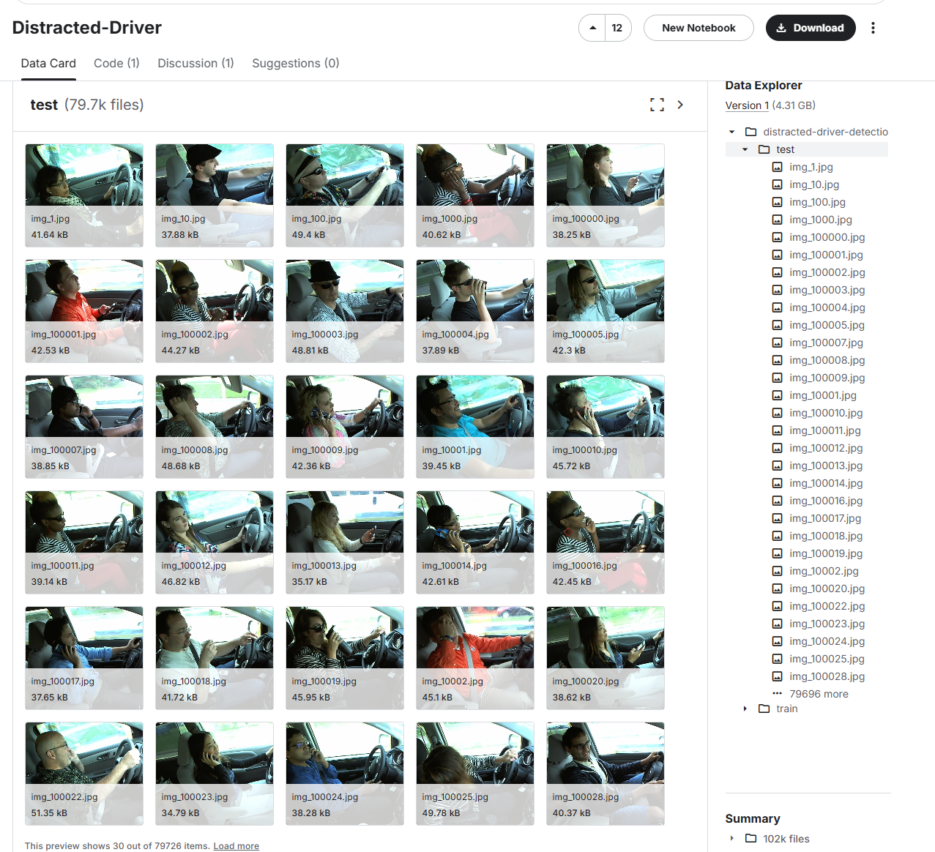
Process
4
Data Preparation
https://www.kaggle.com/datasets/tejakalepalle/auc-distracted-driver-dataset-v1
Three classification: safe driving/using mobile phones/drinking
c0: safe driving
c1: texting - right
c2: talking on the phone - right
c3: texting - left
c4: talking on the phone - left
c5: operating the radio
c6: drinking
c7: reaching behind
c8: hair and makeup
c9: talking to passenger

Slide 9


Process
4
We are here!
Preparation
2. Model Training
Training Dataset Preparation, get familiar with technical skills (YOLO/Dlib)
Create the detecting model and train the model with preprocessed dataset.
Fine-tuning the model to get higher accuracy
4. Testing
3. Integration
Test our system under real circumstance
Design the frontend side for the model and Integrate it with the model.
Once detecting inappropriate behavior, our system would alarm driver with specific sound.

Slide 10

THANK
YOU
Team 06

